Slide 1


FYP-1
Digital Chef Sync
Anas Sabih Sarwar | (2600-2021)
Abu Bakar Balouch | (2167-2021)
Hamza Rafique | (2195-2021)
Supervisor Iqbal Uddin Khan
Department of Computing, FEST
Hamdard University

Slide 2
Summary
Problem Statement
Objective
FYP Scope
Our methodology
Our Project Plan (Time lines)
FYP Deliverables
Budget / Costing
Literature Review
Work (Demo)
References

Slide 3
Problem Statement
"Transforming restaurant staffing through innovative recruitment solutions.“
Restaurant staffing faces outdated processes, limited scalability, and poor communication, leading to staffing gaps and low satisfaction for businesses and workers. Digital Chef Sync solves this with advanced features like real-time job matching, time tracking, and secure payments, streamlining hiring and improving workforce management.

Slide 4
Objective
Enhance User Experience
Streamline Hiring Processes
Automate Administrative Tasks
Enhance Payment Security
Optimize Time Tracking
Reduce Hiring Complexity
Ensure High Availability and Uptime
Promote Eco-Friendly and Digital Solutions
Skill Matching and notification
Enable 24/7 Platform Accessibility

Slide 5
FYP Scope
Digital Chef Sync is a specialized staffing and workforce management platform designed to streamline hiring and staff management in the food industry. It exclusively serves job seekers—including Chefs, Head Chefs, Kitchen Staff, and Waiters—and job recruiters, such as Restaurants and Event Management Companies, ensuring a highly targeted and efficient recruitment process.
The platform enables skill-based job matching, allowing businesses to connect with suitable candidates based on experience and availability. Real-time notifications, automated communication, and smart scheduling help recruiters manage staffing needs quickly and efficiently. Additionally, integrated time tracking and invoicing allow businesses to monitor work hours and generate accurate payroll records, ensuring seamless financial management.

Slide 6
FYP Scope
A key feature of Digital Chef Sync is its secure in-app wallet, which facilitates direct salary payments and financial transactions between recruiters and employees, minimizing delays and ensuring compliance with payment policies. By reducing hiring time, optimizing workforce allocation, and enhancing financial transparency, Digital Chef Sync provides a cost-effective, efficient, and scalable solution for modern Food Industry, improving both staffing reliability and operational efficiency.

Slide 7
Our Methodology
The project follows the SCRUM methodology, ensuring iterative development and continuous improvement. Key elements of this approach include:
Sprints: Short iterations lasting 2-4 weeks to break down the project into manageable phases.
Daily Stand-up Meetings: Team members discuss progress, challenges, and plans for the day.
Sprint Planning: At the beginning of each sprint, tasks from the product backlog are selected for completion.
Sprint Reviews: At the end of each sprint, the completed work is demonstrated to stakeholders for feedback.
Sprint Retrospective: The team reflects on the sprint's progress, identifying areas of improvement for the next cycle.

Slide 8
Our Project Plan
Phases/Activity | Duration
Project Initiation and Preparation | 3 weeks
Competitive Analysis | 4 weeks
Design and Prototyping | 3 weeks
Design Database | 4 weeks
Develop Database | 8 weeks
Design Mobile App | 4 weeks
Develop Mobile App | 10 weeks
Testing and Optimization | 8 weeks
Documentation and Launch Preparation | 4 weeks
Total Estimated Duration | 48 weeks

Slide 9
Budget / Costing
Estimated budget of project major resources
Hard Drive (Rs. 15,000 x 2 = PKR 30,000 est.)
Laptop (Rs. 60,000 x 3 = PKR 180,000 est.)
Mobile ( 45,000 x 2 = PKR 90,000 est.)
Electricity (Rs. 3000 x 12 = PKR 36,000 est.)
Internet (3500 x 12 = PKR 42,000 est.)
Industry Expert Consultancy (expected 2-4 visits) 8000 x 2 = PKR 16,000 est.
HP Smart Tank Printer (PKR 36,000)
Miscellaneous PKR 10,000 est.
Total cost PKR 440,000‬ est.
*Detailed budget sheet will be provide.

Slide 10
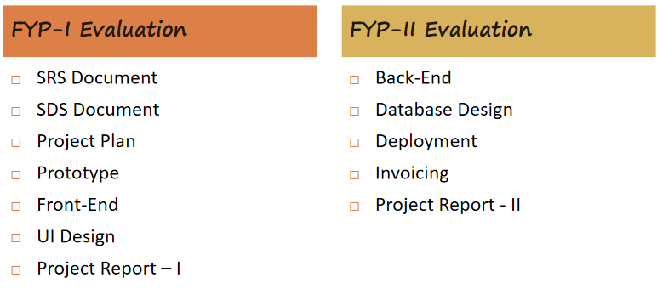
FYP Deliverables

Slide 11
Literature Review
Traditional food industry hiring relies on manual processes, resulting in delays and poor job-role matching.
Existing platforms like Rozee.pk and JobToday are made for all types of jobs and are not designed for the food industry. They do not have smart filters for skills, cannot match based on job roles, and do not support shift-based hiring — which makes them a poor choice for fast and active environments like restaurants and events.
No unified platform currently integrates skill-based job matching, time tracking, in-app wallet, and automated invoicing.
Studies show increasing demand for mobile-first, on-demand recruitment in the hospitality sector.
Digital Chef Sync fills this gap by combining automation, scalability, and real-time communication into one system.

Slide 12

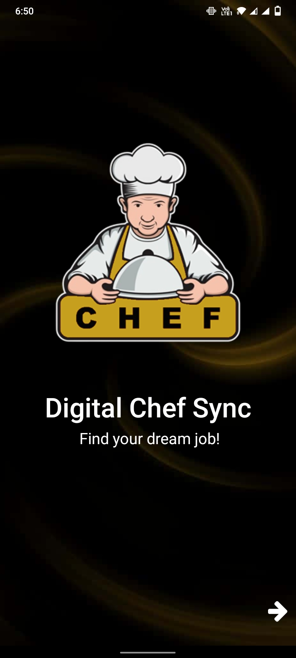
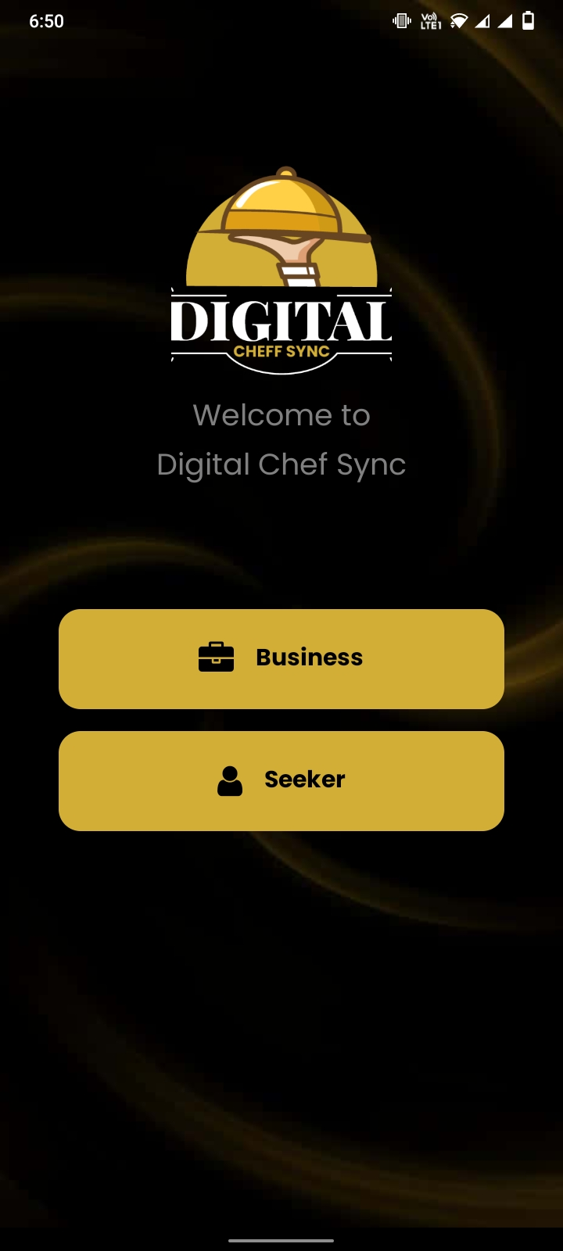
Demo of Wrok

Slide 13
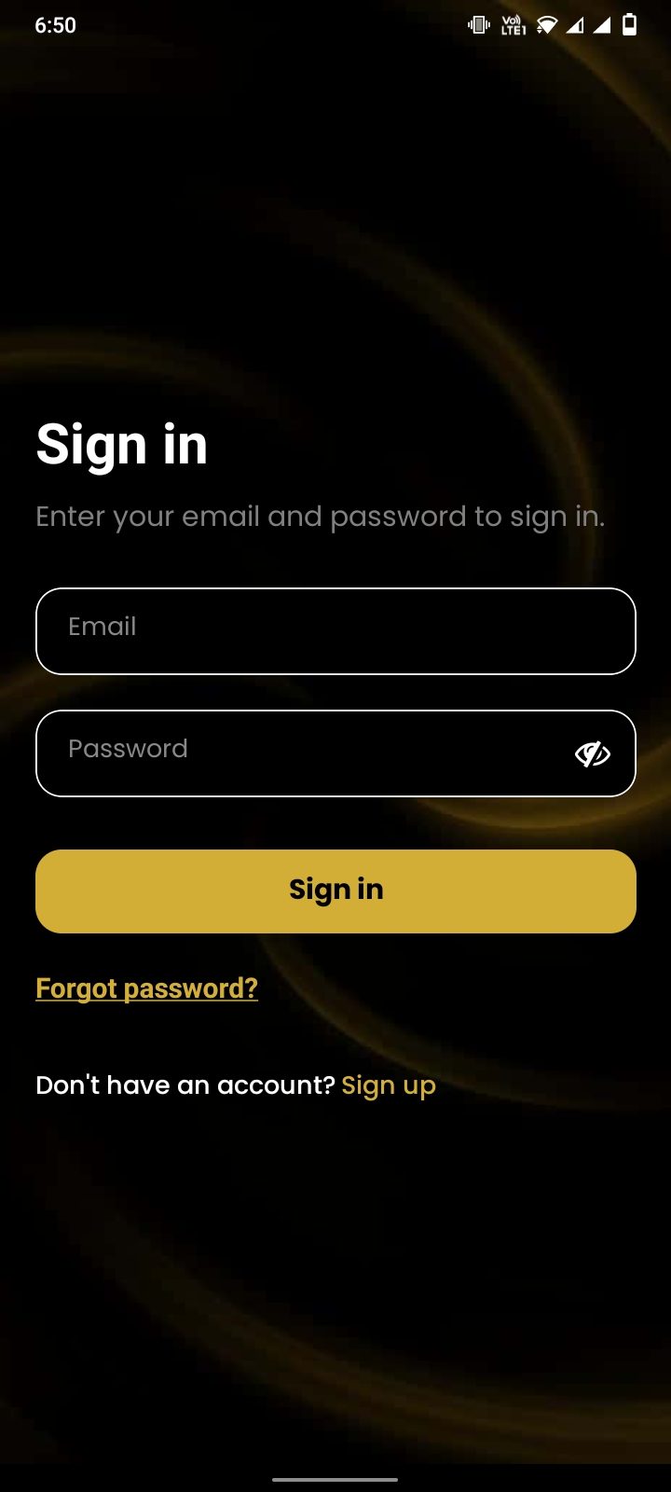
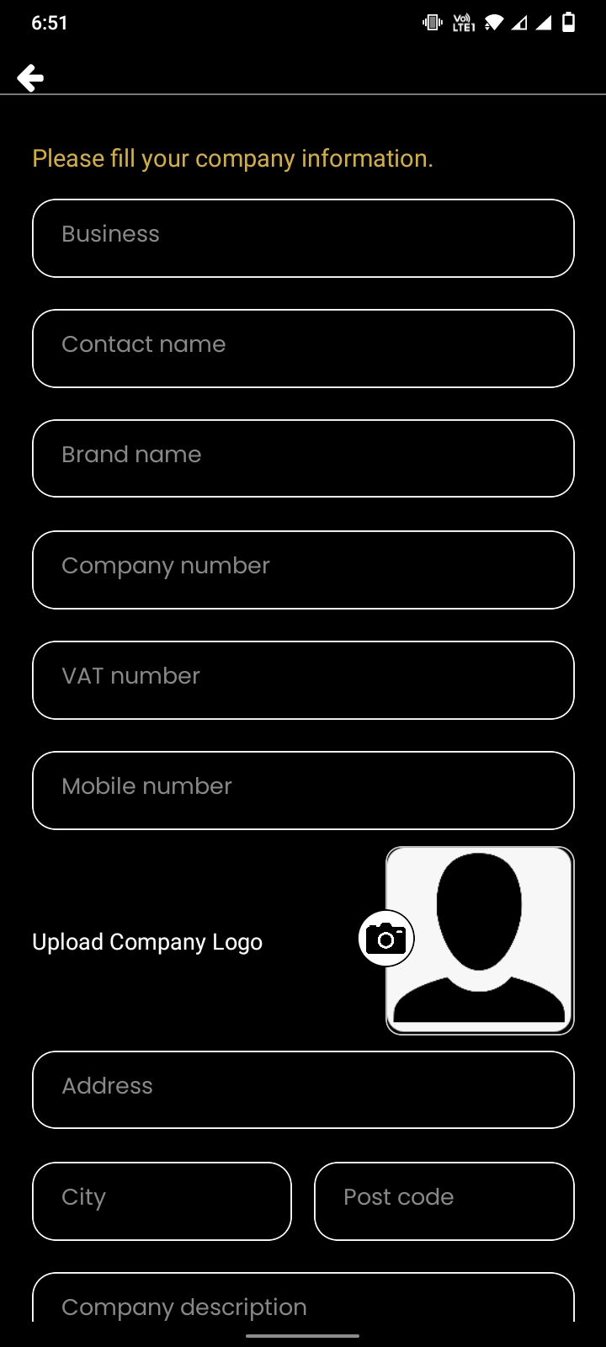
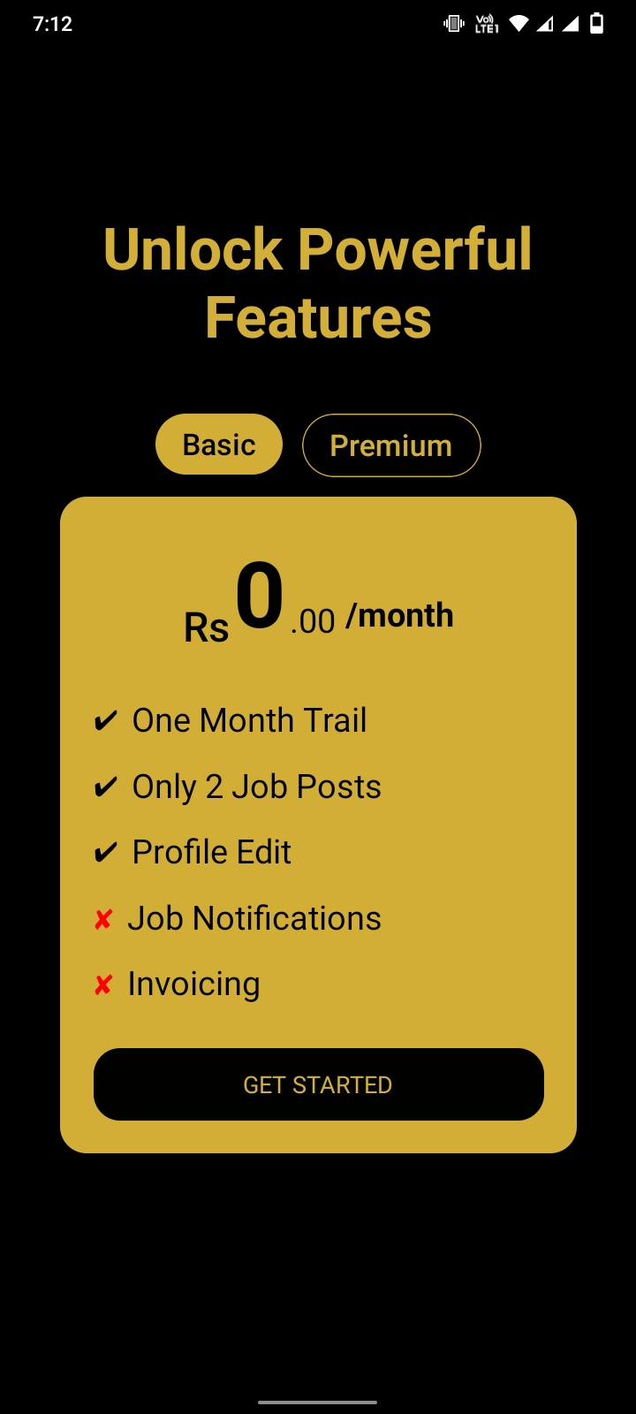
Business View

Slide 14
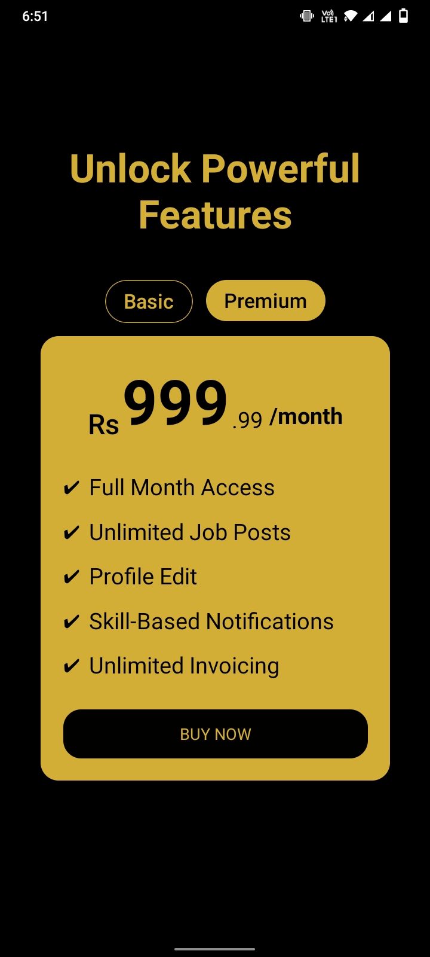
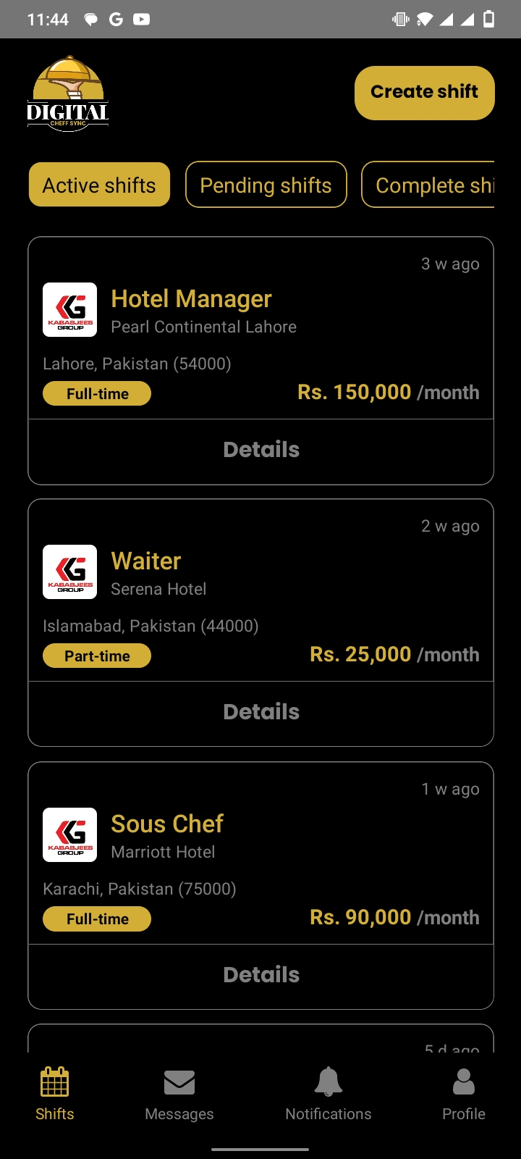
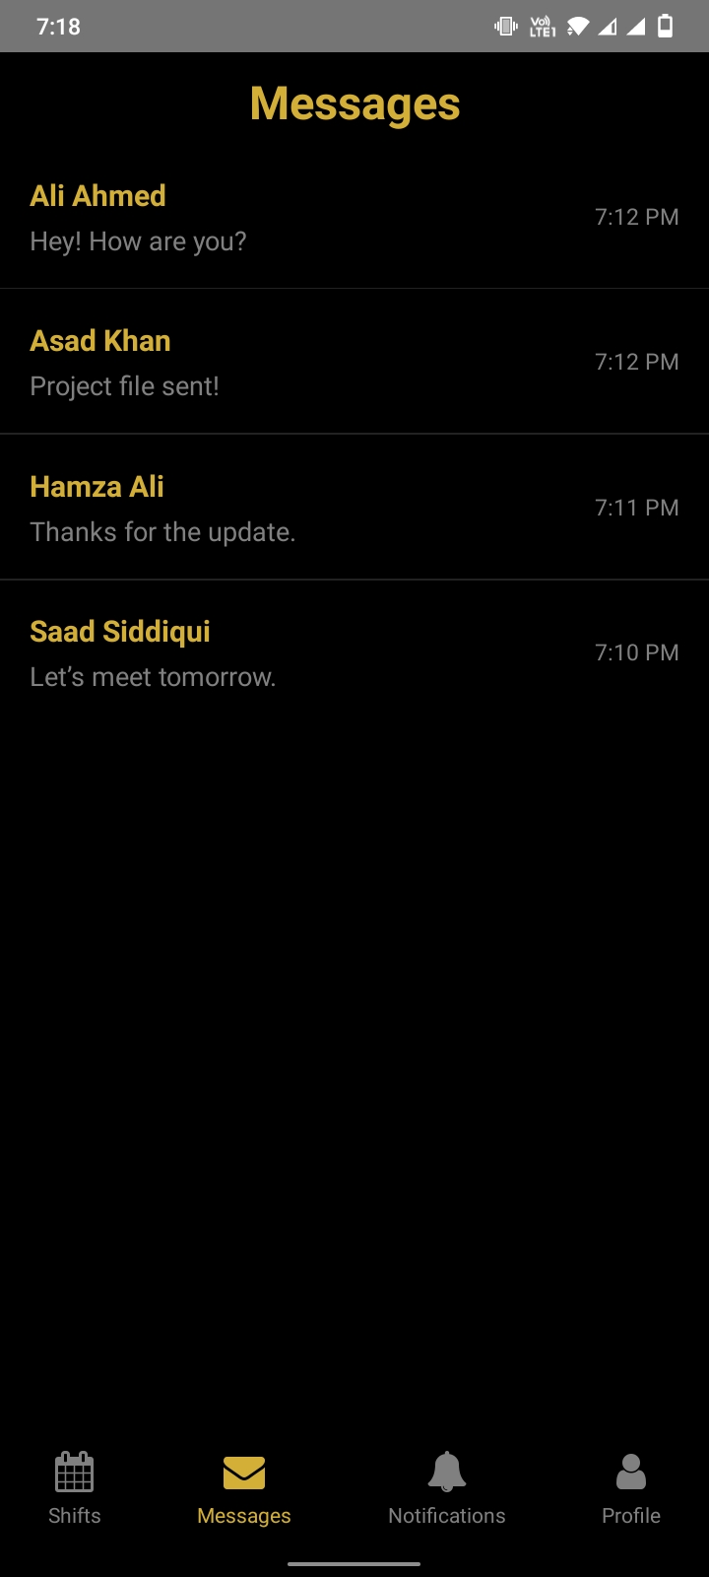
Business View

Slide 15
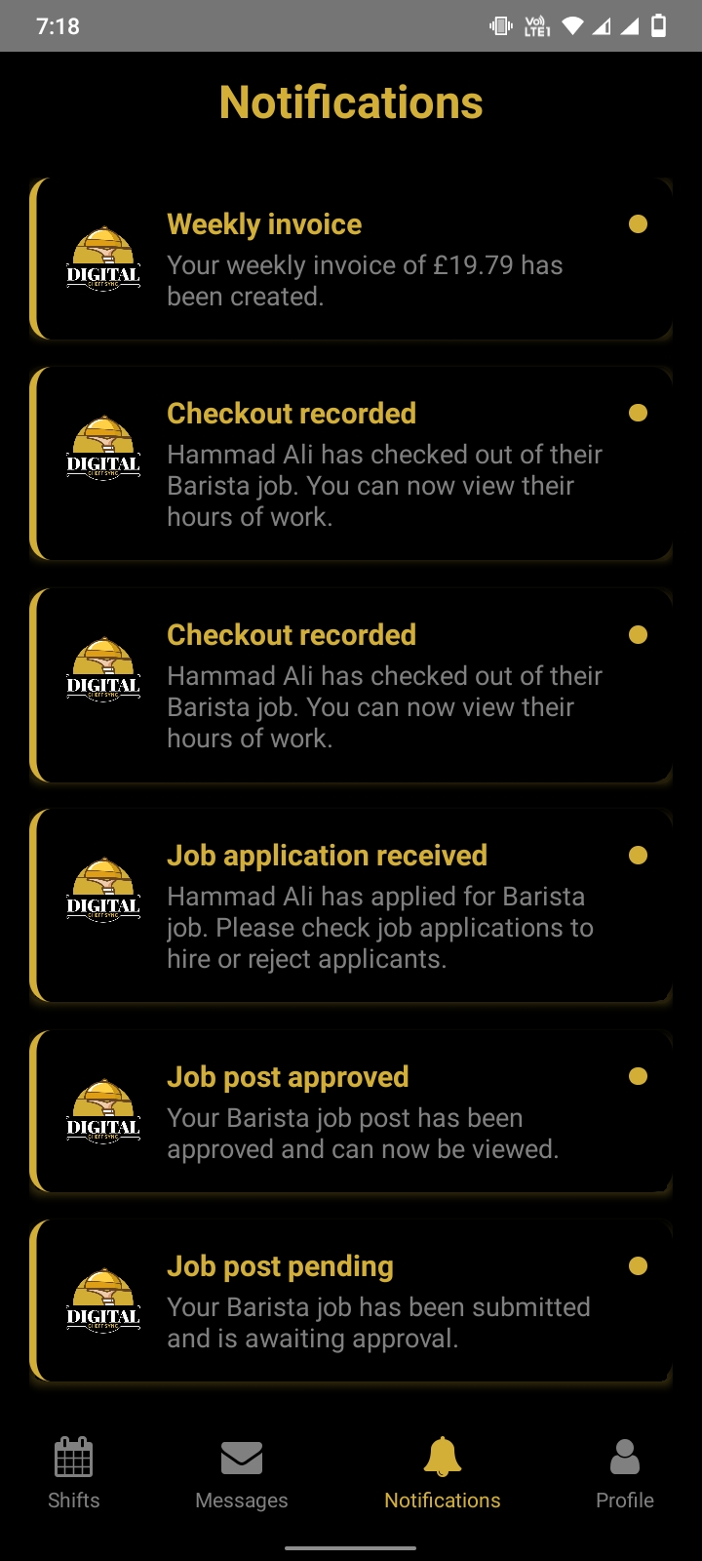
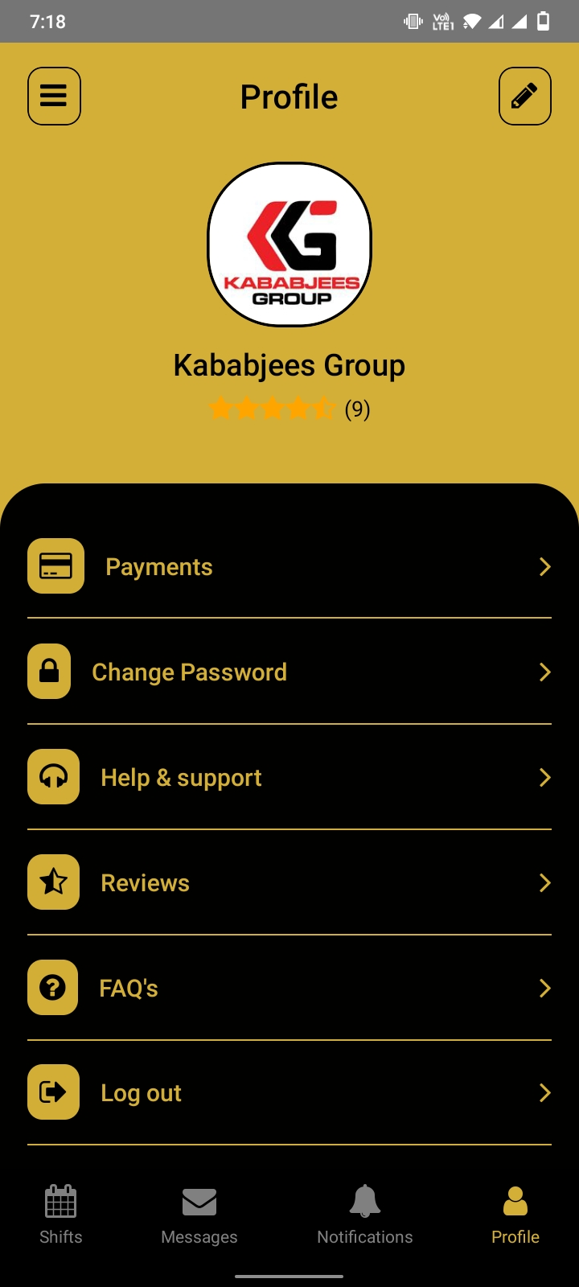
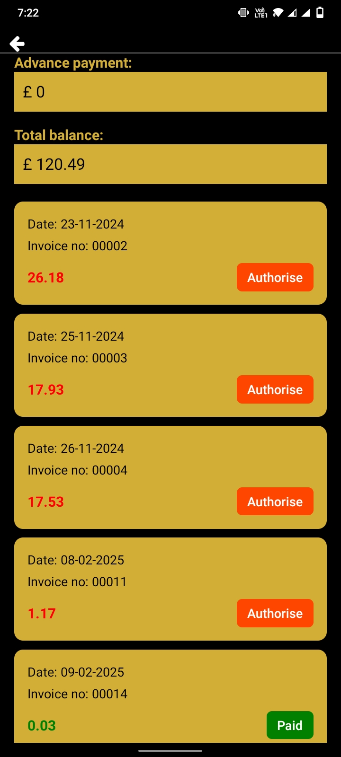
Business View

Slide 16
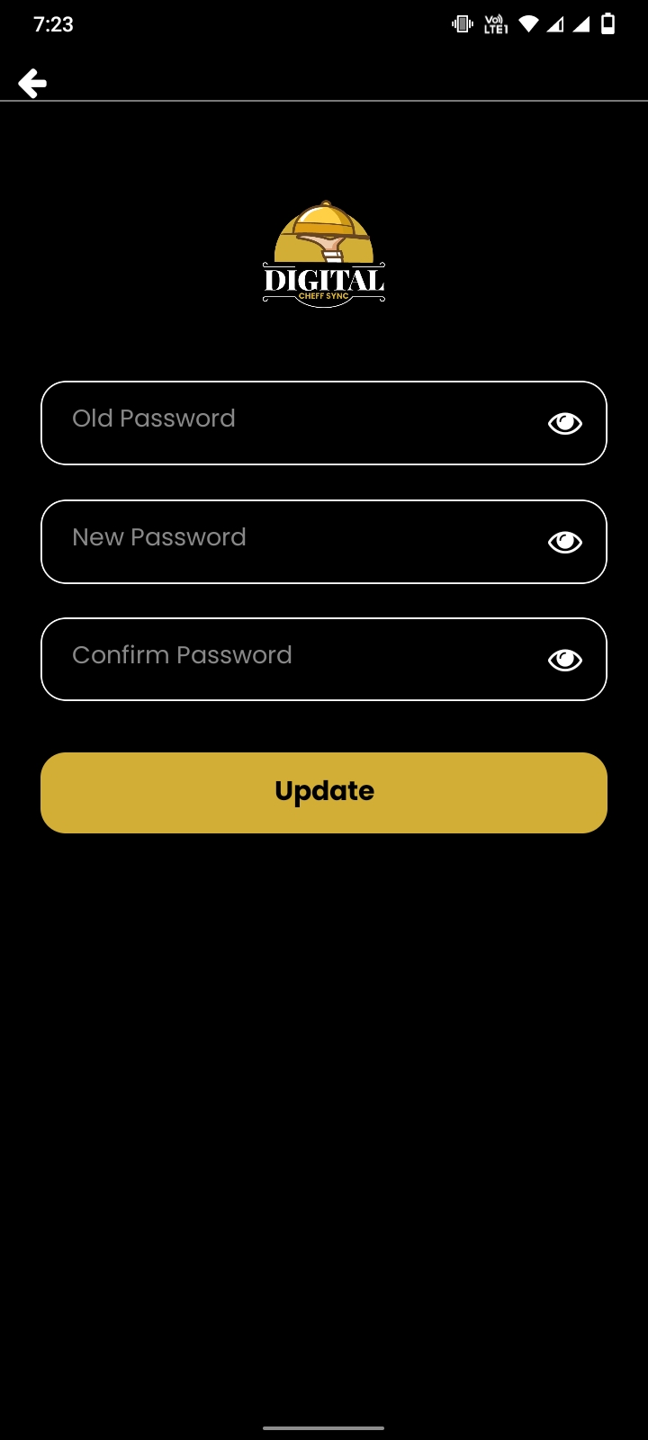
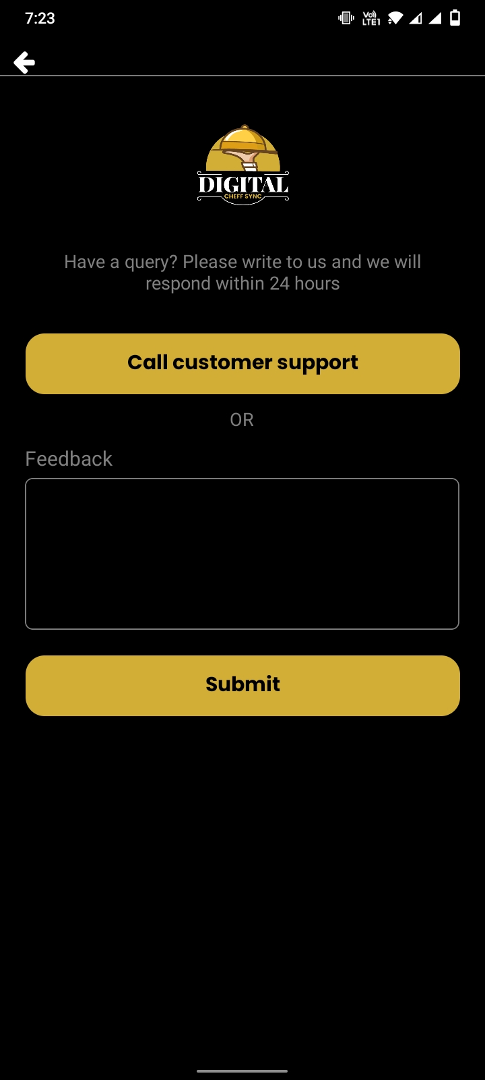
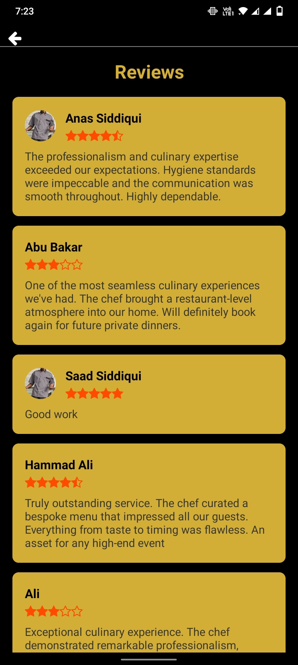
Business View

Slide 17
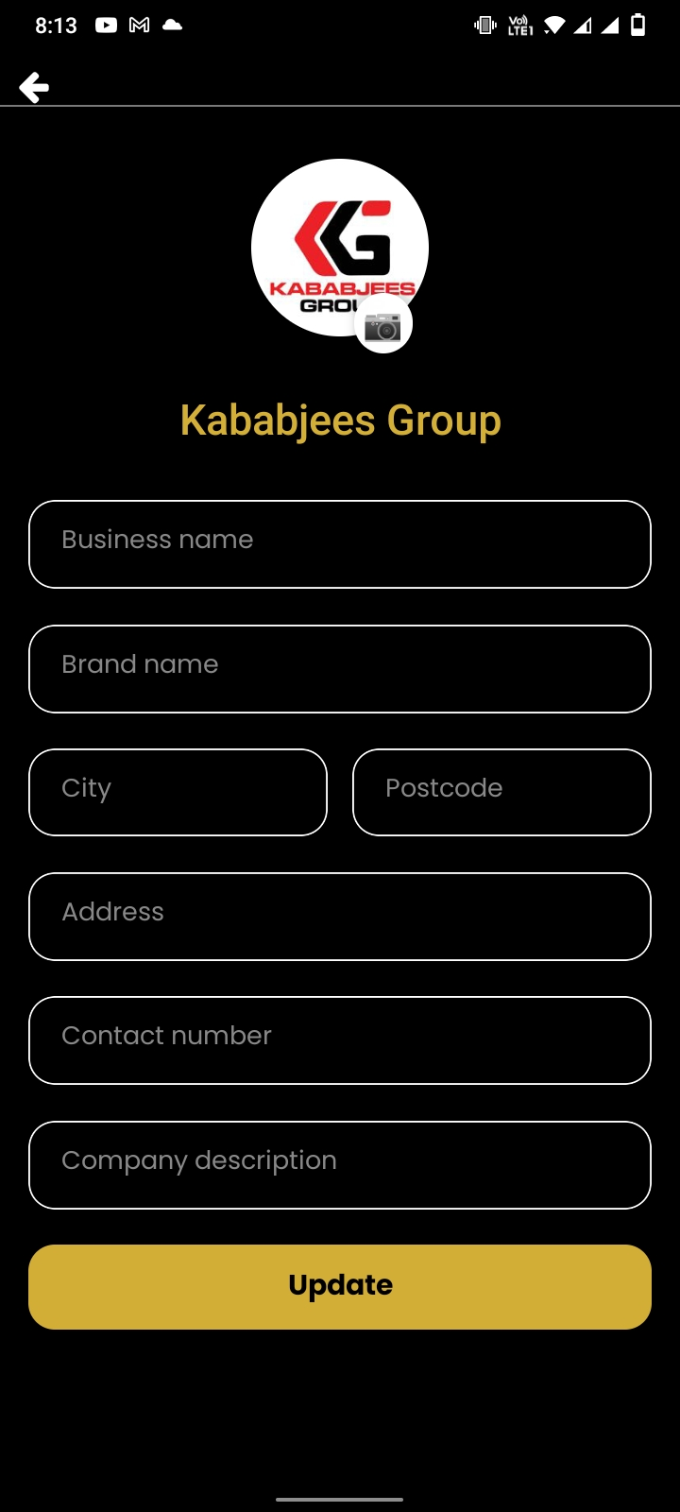
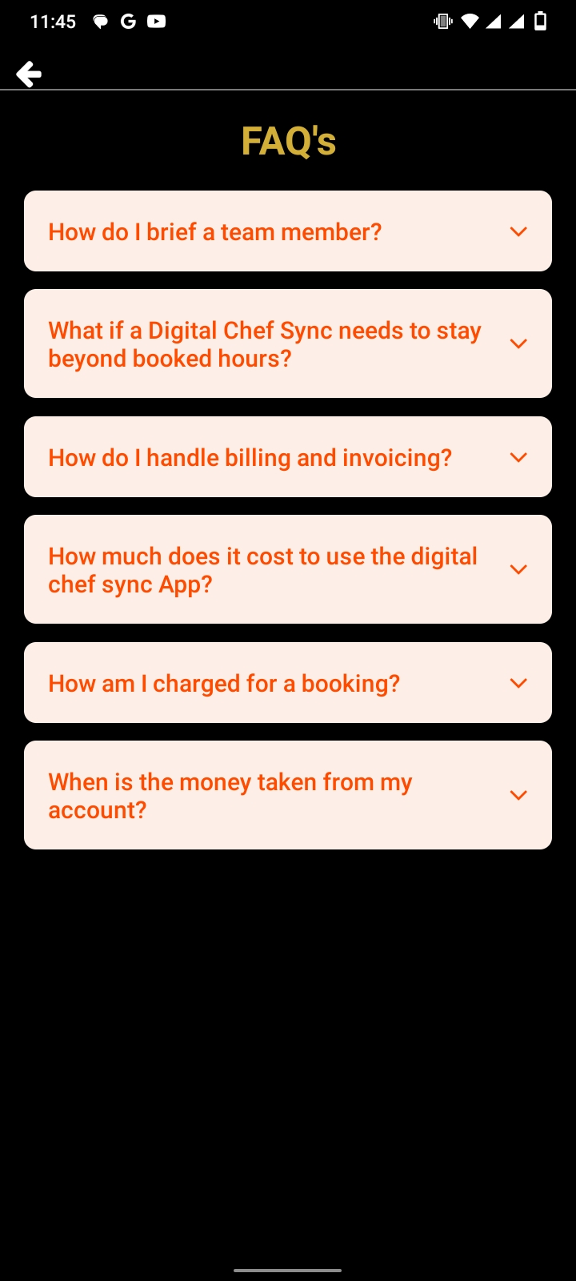
Business View

Slide 18
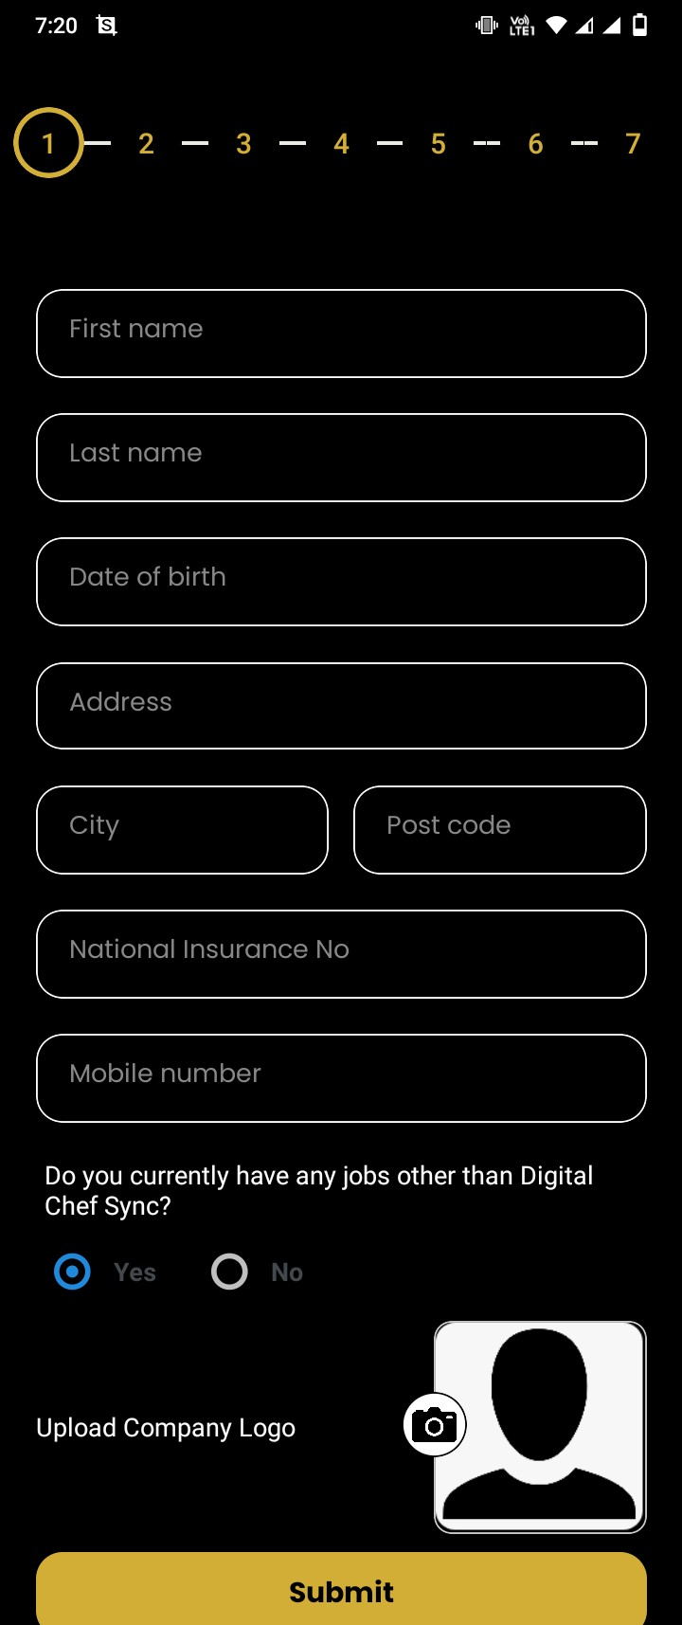
Seeker View

Slide 19
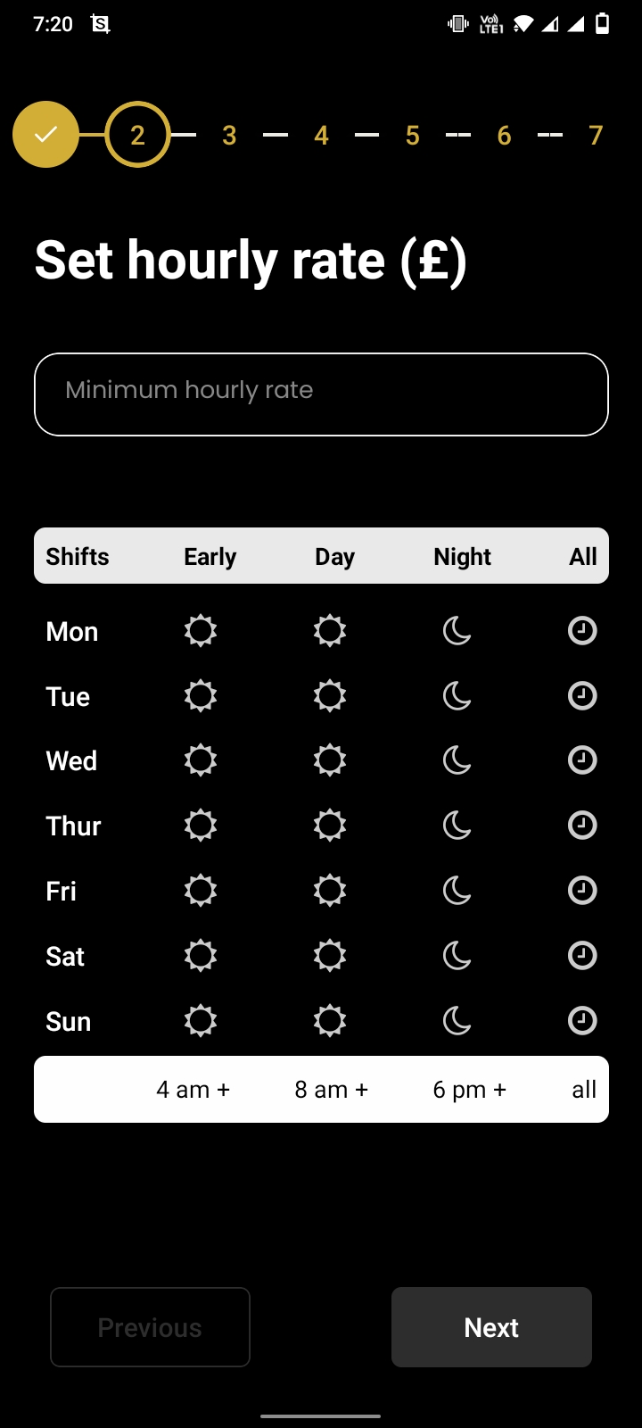
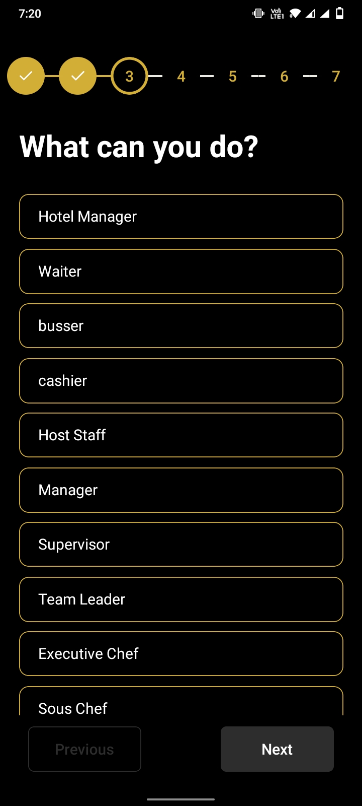
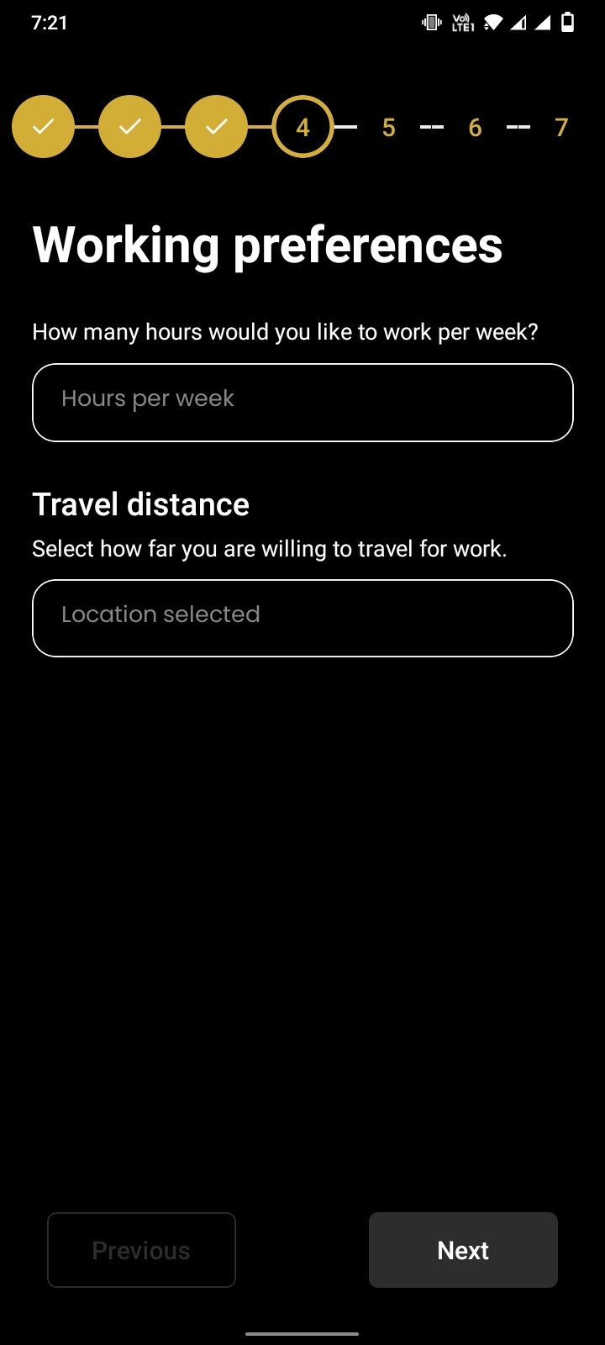
Seeker View

Slide 20
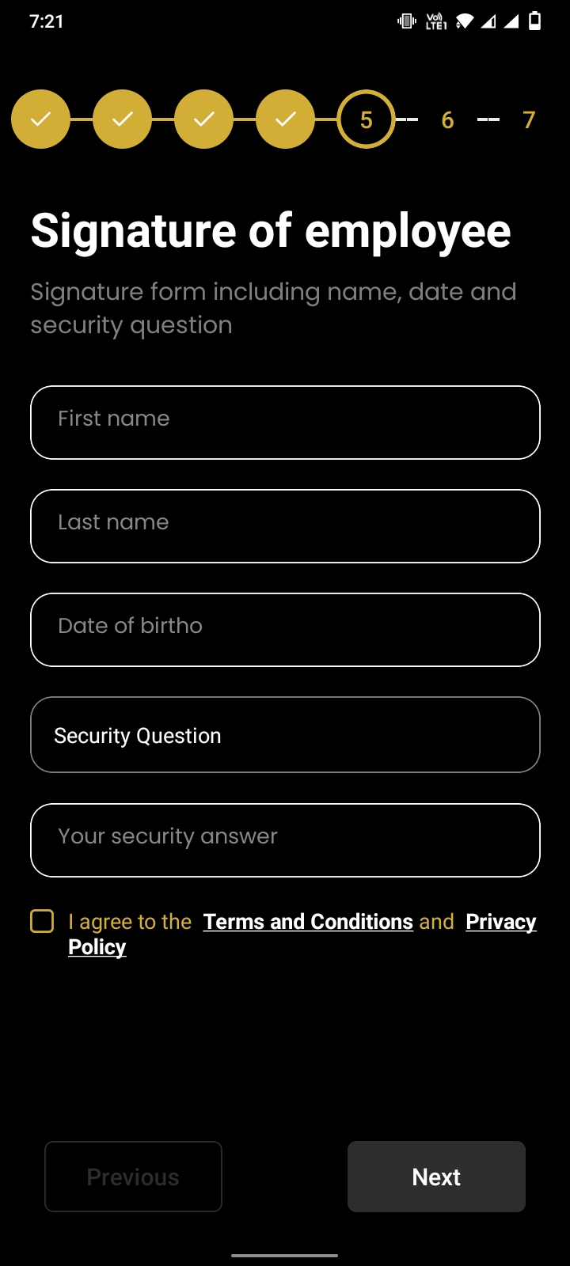
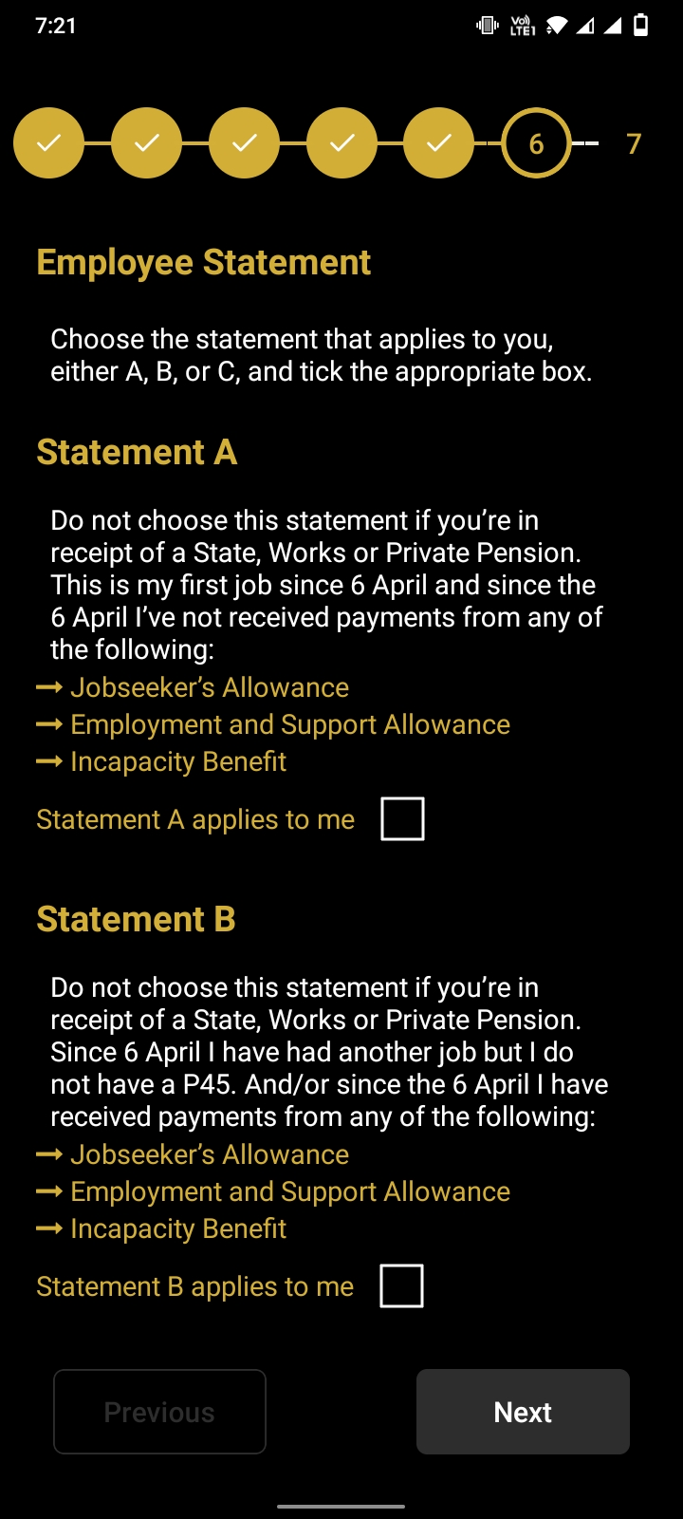
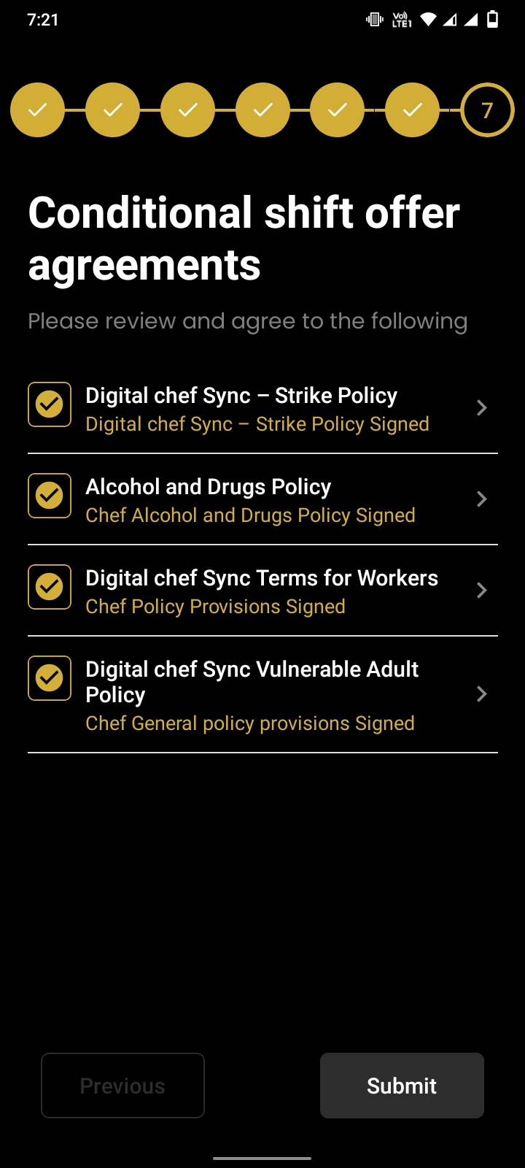
Seeker View

Slide 21
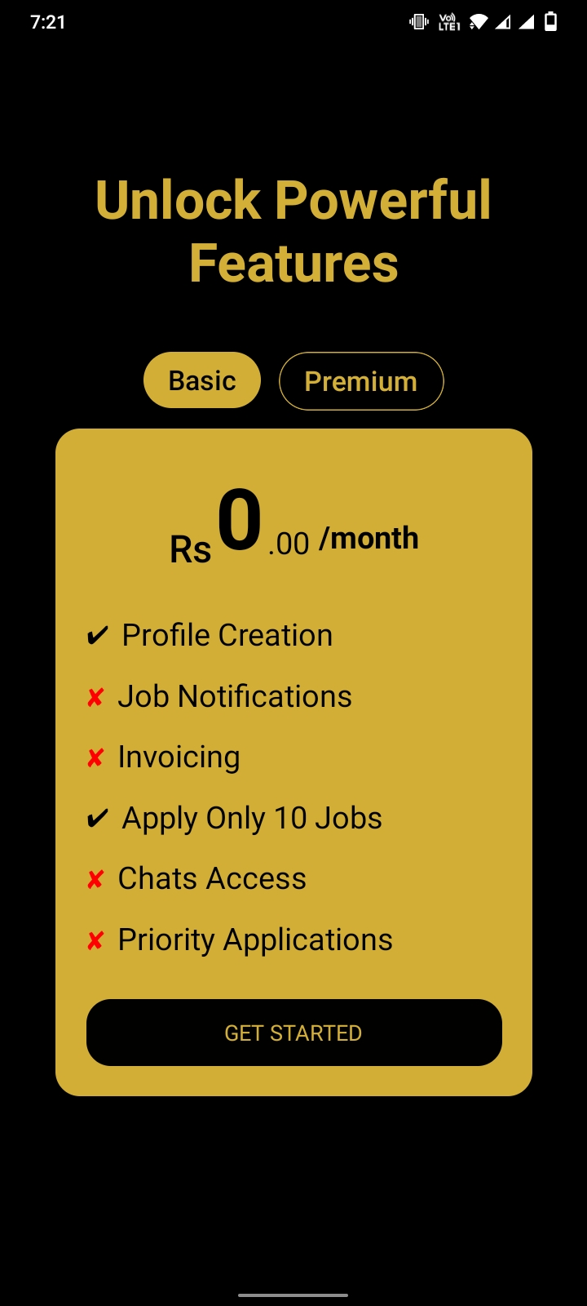
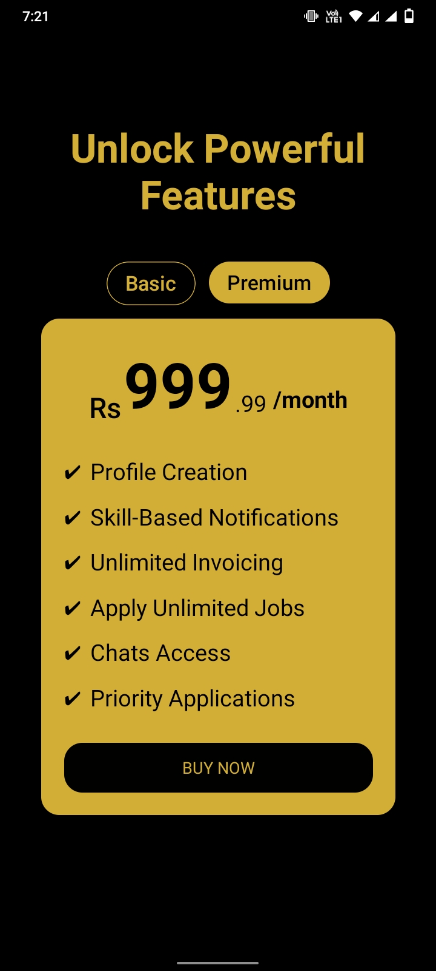
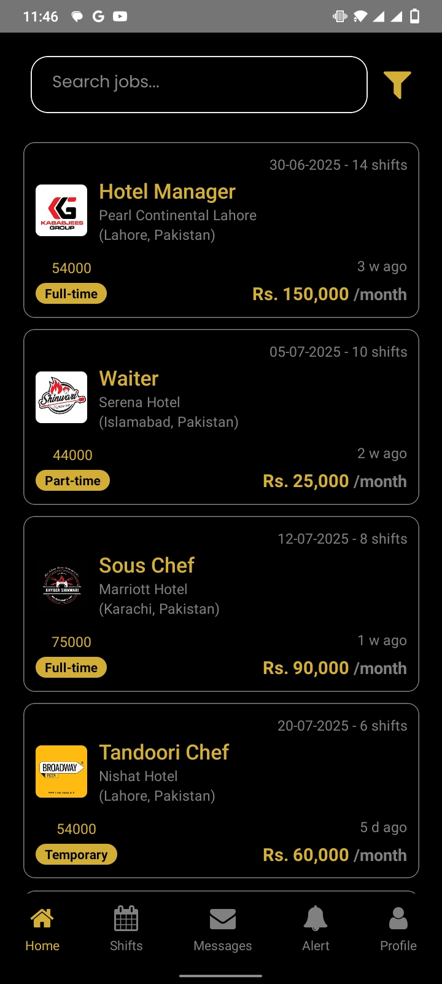
Seeker View

Slide 22
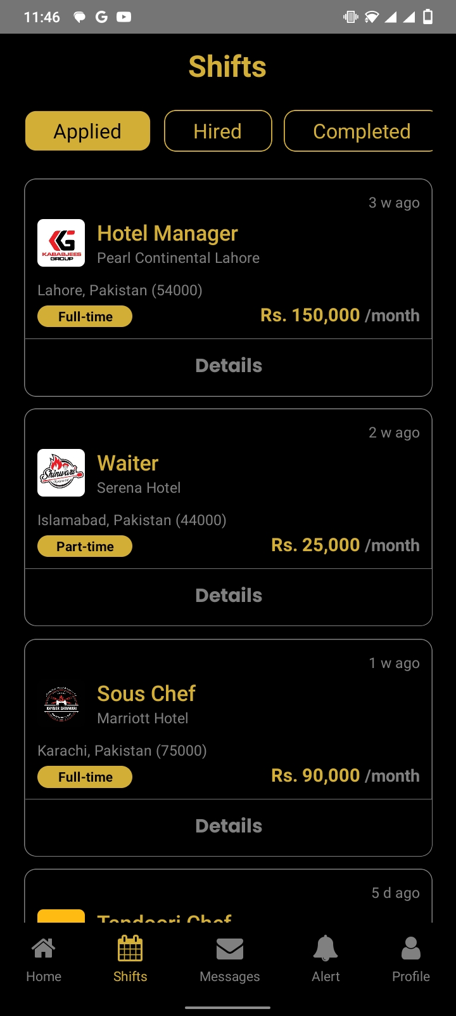
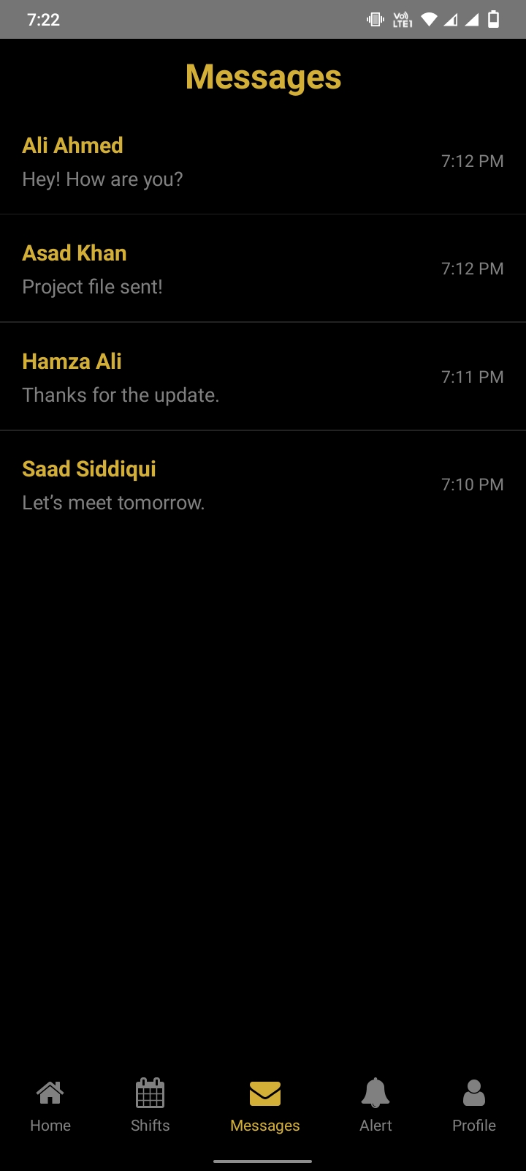
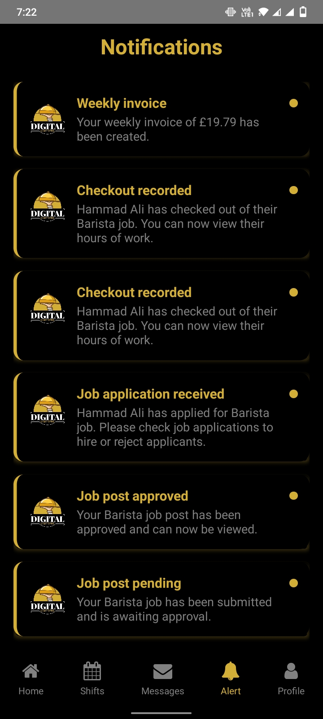
Seeker View

Slide 23
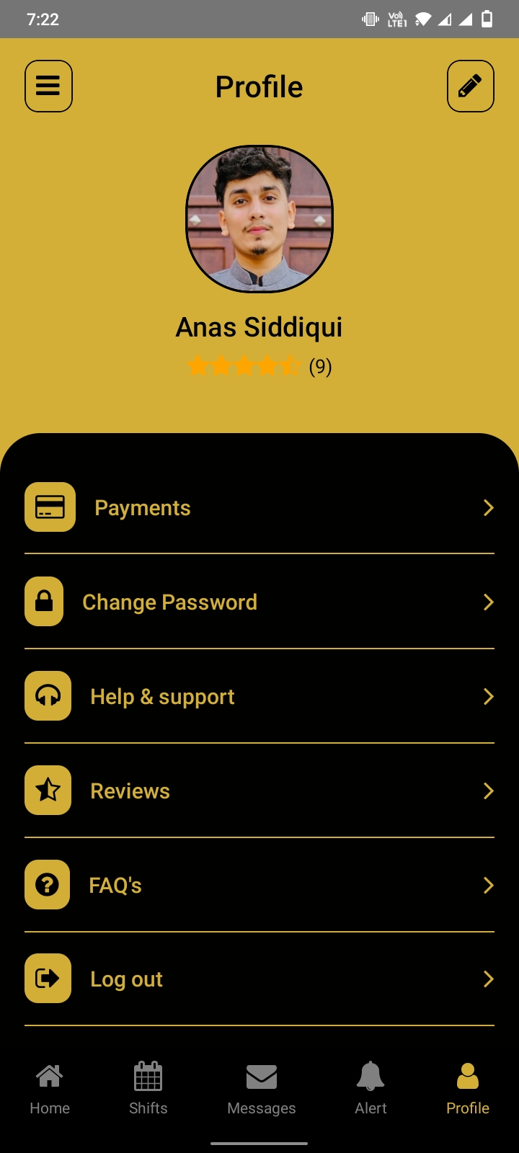
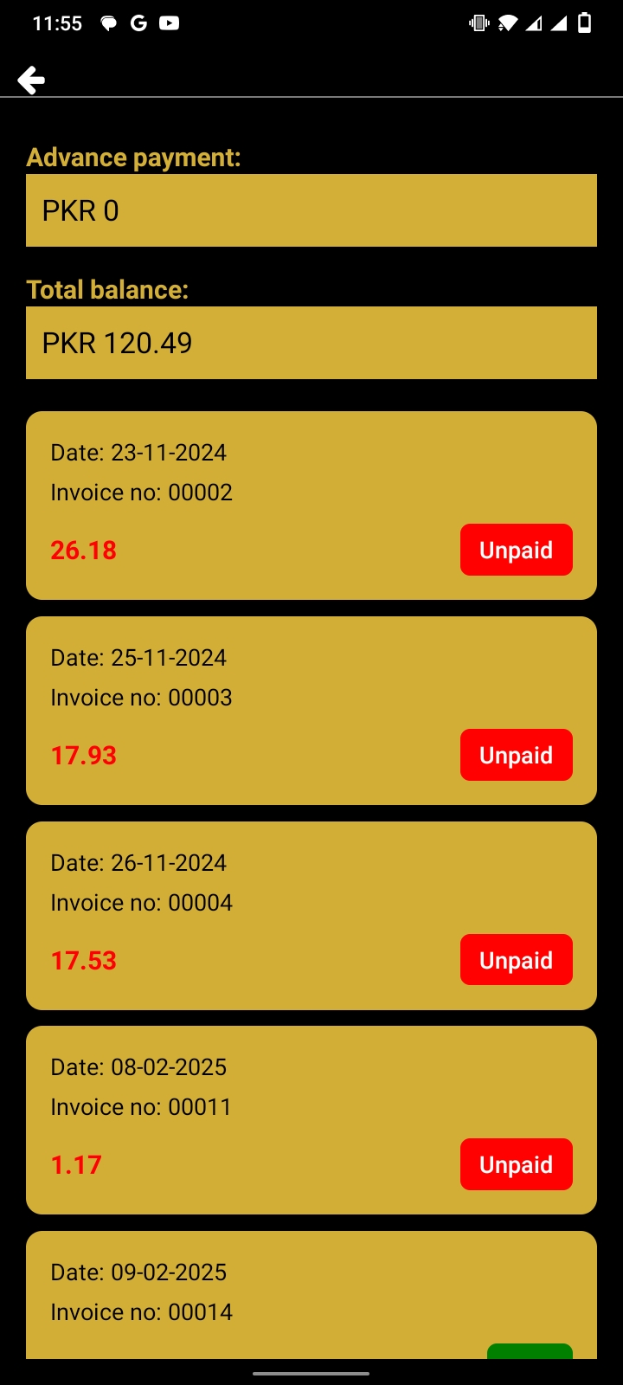
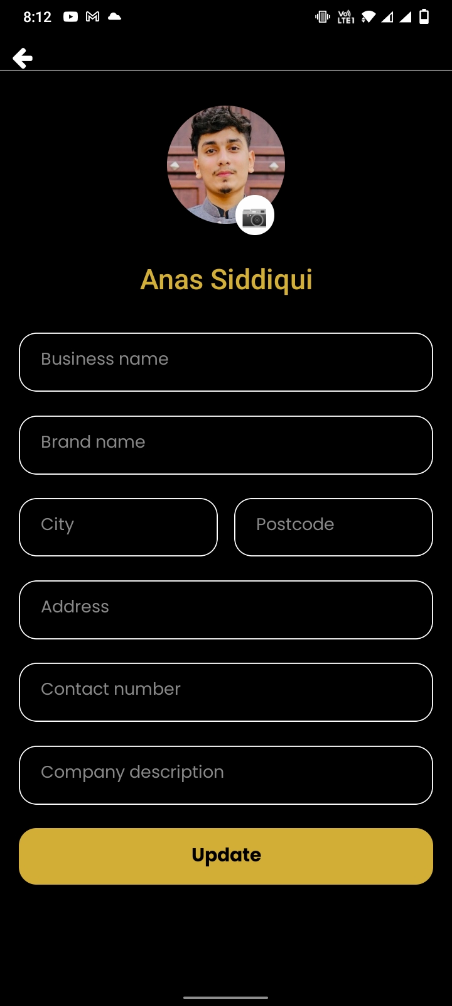
Seeker View

Slide 24
Reference
https://www.workstream.us/blog/restaurant-hiring-software
https://www.qsrmagazine.com/emerging-tech/how-tech-changing-restaurant-staffing
https://pos.toasttab.com/blog/on-the-line/hiring-restaurant-staff

